Slide 1
From Raw Reads to Gene Insights : RNA-Seq Analysis of Human LCLs (Lymphoblastoid cell lines)

Slide 2
Subtitle : An exploration of gene expression in Yoruba individuals using public RNA-Seq data Course : Bioinformatics with Advance AI Date : 19 July 2025
Presented by :
Muskan Kashyap, Benika, Sheeba Ansari, Palak, Arshvi Meshram

Slide 3

Project Overview : Organism: Homo sapiens (Human) Sample: YRI Lymphoblastoid Cell Line SRA Project ID: PRJNA207555 SRA Run ID: SRR19762473

Slide 4
Why Chose This Dataset:
✅ Population-Specific Insight The dataset represents Yoruba individuals in Ibadan, Nigeria (YRI), which is one of the most studied African populations in genomics — valuable for population genetics and expression variability.
✅ Well-Characterized Samples Lymphoblastoid cell lines (LCLs) are widely used in functional genomics because they're standardized, renewable, and consistent across studies.
✅ Part of the 1000 Genomes Project This makes the data reliable and extensively annotated, allowing for comparison with genomic variation data.
✅ Publicly Available & High Quality The data is open-access, peer-reviewed, and associated with detailed metadata, which supports reproducibility.
✅ Suitable for RNA-Seq Analysis The data includes paired-end RNA-seq reads — ideal for studying gene expression, alternative splicing, and transcript assembly.

Slide 5

Workflow Steps :
Download SRR files from NCBI SRA
Convert .sra → .fastq using fasterq-dump
Quality check with FASTQC (before trimming)
Trim low-quality reads and adapters with Trimmomatic
Re-check quality with FASTQC (after trimming)
Align reads to human genome (hg38) using BWA
Convert & sort alignment files using SAMtools
Visualize alignments in IGV
9. Perform variant calling
10. Reflect and report biological insights

Slide 6
FASTQC Analysis
To assess the quality of raw sequencing data.

Slide 7
Step 1: Data Download and Conversion:
Downloaded SRR file using SRA Toolkit:
Command: prefetch SRR19762473
Converted .sra to .fastq format:
Command: fastq-dump --split-files SRR19762473.sra
Output:
SRR19762473_1.fastq
SRR19762473_2.fastq (Paired-end data)

Slide 8
Step 2: Quality Control with FastQC:
Performed FastQC analysis on both .fastq files:
fastqc SRR19762473_1.fastq SRR19762473_2.fastq
Output:
SRR19762473_1_fastqc.html
https://muskan-fastqc-report-1.netlify.app/
SRR19762473_2_fastqc.html
https://muskan-fastqc-report-2.netlify.app/

Slide 9
Trimmomatic analysis
A popular tool for trimming low-quality bases and removing adapters from FASTQ files before alignment or quantification.

Slide 10
Read Trimming with Trimmomatic :
Tool Used:
Trimmomatic v0.39
Input Files (Raw FASTQ):
SRR19762473_1.fastq
SRR19762473_2.fastq
Adapter Removal:
Adapter file used, TruSeq3-PE.fa
(Illumina TruSeq adapters, downloaded from GitHub)
Clipping parameters:
ILLUMINACLIP:TruSeq3-PE.fa:2:30::10

Slide 11
Read Trimming with Trimmomatic:
Output Files:
Paired reads:
SRR19762473_1_paired.fastq
https://muskan-srr19762473-1-paired-fastqc.netlify.app
SRR19762473_2_paired.fastq
https://muskan-srr19762473-1-unpaired-fastqc.netlify.app
2. Unpaired reads:
SRR19762473_1_unpaired..fastq
https://muskan-srr19762473-2-paired-fastqc.netlify.app
SRR19762473_2_unpaired.fastq
https://muskan-srr19762473-2-unpaired-fastqc.netlify.app

Slide 12
BWA Alignment
To align trimmed paired-end RNA-Seq reads to the human reference genome (hg38) using the BWA-MEM algorithm.

Slide 13
Workflow Performed:
1. Indexing the Reference Genome -
Command: bwa index hg38.fa
Output: .amb, .ann, .bwt, .pac, .sa files
2. Aligning Paired-End Reads -
Command: bwa mem hg38.fa SRR19762473_1_paired.fastq SRR19762473_2_paired.fastq > SRR19762473_aligned.sam
3. SAM to BAM Conversion -
Command: samtools view -bS SRR19762473_aligned.sam > SRR19762473_aligned.bam
4. Sorting BAM File -
Command: samtools sort SRR19762473_aligned.bam -o SRR19762473_aligned_sorted.bam
5. Indexing BAM File -
Command: samtools index SRR19762473_aligned_sorted.bam

Slide 14
📂 Output Files from BWA Alignment
Reference Genome Indexing (bwa index):
hg38.fa.amb, hg38.fa.ann, hg38.fa.pac, hg38.fa.sa
2. BWA MEM Alignment:
SRR19762473_aligned.sam (SAM file containing raw alignment results)
3. SAM to BAM Conversion (samtools view):
SRR19762473_aligned.bam (Binary version of the SAM file, more efficient for processing)
4. BAM Sorting (samtools sort):
SRR19762473_aligned_sorted.bam (Coordinate-sorted BAM file, required for indexing and visualization)
5. BAM Indexing (samtools index):
SRR19762473_aligned_sorted.bam.bai (Index file for efficient random access in IGV or downstream tools)

Slide 15
IGV Visualization of Aligned Reads
To visualize the aligned sequencing reads (.bam) on the human reference genome (hg38) using Integrative Genomics Viewer (IGV)

Slide 16
Steps Performed:
Launched IGV Desktop App -
Version: 2.19.5 with built-in Java
2. Loaded Reference Genome -
Selected Human hg38 from IGV genome list
3. Loaded Aligned Data -
Loaded SRR19762473_aligned_sorted.bam and its index .bai
4. Navigation –
Jumped to region chr1:1,006,000–1,006,500 using the search bar.
Zoomed in to observe aligned reads and mismatches.

Slide 17
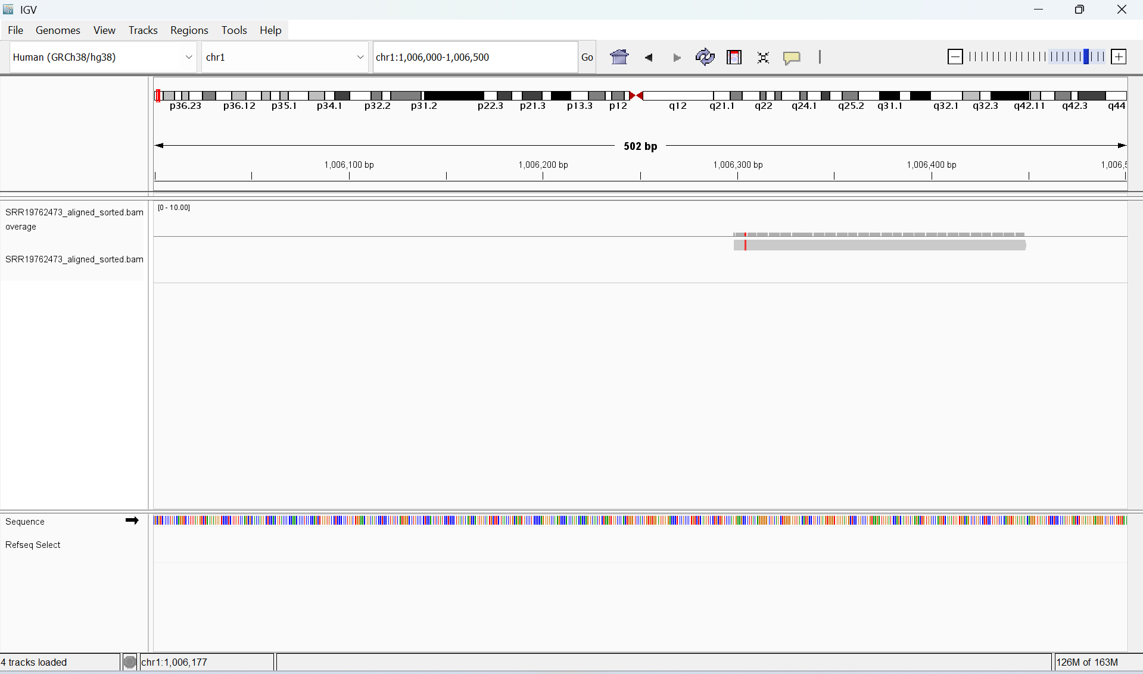

Slide 18
🧬 IGV Visualization of Aligned Reads :
This image shows a zoomed-in view of aligned sequencing reads from the file SRR19762473_aligned_sorted.bam visualized using IGV over the hg38 reference genome at region chr1:1,006,000–1,006,500.
Interpretation:
Gray bars represent individual reads successfully aligned to the reference genome.
A red bar indicates a mismatch (potential SNP or sequencing error) at that base position.
The bottom sequence track shows the reference genome bases.
The "Coverage" track (gray histogram above the reads) is visible but shallow, indicating low depth (~1–10 reads) at this locus.

Slide 19
Variant Calling & Interpretation
Tools Used: BCFtools for variant calling, conversion, and filtering

Slide 20
Steps Performed:
Variant Calling -
Used bcftools mpileup and bcftools call to identify genomic variants.
Command:
bcftools mpileup -Ou -f hg38.fa SRR19762473_aligned_sorted.bam | \
bcftools call -mv -Ob -o SRR19762473_variants.bcf
2. BCF to VCF Conversion -
Converted binary BCF to human-readable VCF format.
Command:
bcftools view SRR19762473_variants.bcf -Ov -o SRR19762473_variants.vcf

Slide 21
Steps Performed:
3. Variant Filtering -
Retained only high-quality variants (QUAL > 30 and DP > 10)
Command:
bcftools filter -i 'QUAL>30 && DP>10' SRR19762473_variants.vcf \
-Ov -o SRR19762473_variants_filtered.vcf
Output Files:
SRR19762473_variants.bcf – Raw variant calls
SRR19762473_variants.vcf – Converted VCF file
SRR19762473_variants_filtered.vcf – Final filtered high-confidence variants

Slide 22
Visualize Variants in IGV:
Open IGV on your Desktop
Set Genome to hg38 -
Select "Genome" → "Load Genome" → "hg38“
3. Load the BAM file -
Go to File → Load from File...
Navigate to your bwa_align directory
Select SRR19762473_aligned_sorted.bam
4. Load the VCF file -
Again go to File → Load from File...
Select SRR19762473_variants_filtered.vcf
5. Navigate to a region with variants -
Search bar at the top (type: chr1:1000000-1010000)
You’ll see reads in the BAM track and variant markers (colored) in the VCF track

Slide 23
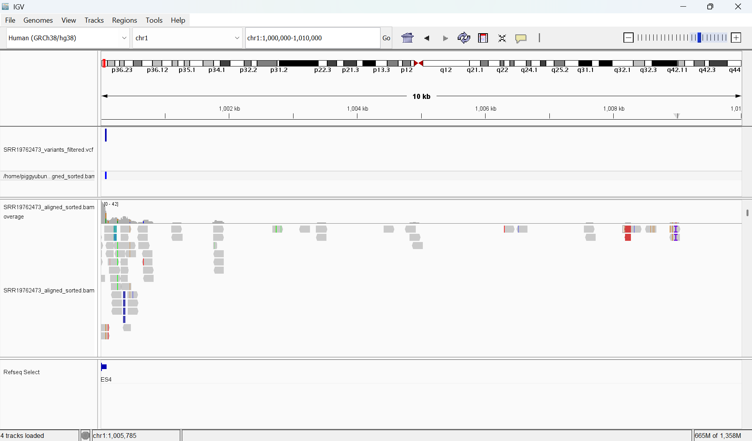

Slide 24
🔍 What We See in the Visualization:
Coverage Track (SRR19762473_aligned_sorted.bam):
Displays read depth across the selected genomic region. The height of the vertical bars indicates how many sequencing reads align at each base — giving a sense of coverage.
Alignments Track:
Shows individual sequencing reads as gray rectangles.
Colored marks (e.g., red, blue, purple) highlight mismatches, insertions, or deletions compared to the reference genome.
This helps visually confirm the presence of real variants versus sequencing errors.
VCF Track (SRR19762473_variants_filtered.vcf):
Displays high-confidence variants called from the data.
Only variants passing the filter QUAL > 30 && DP > 10 are shown.
These represent reliable single-nucleotide variants (SNVs) or indels discovered in the sample.

Slide 25
Thank you

